Slide 1


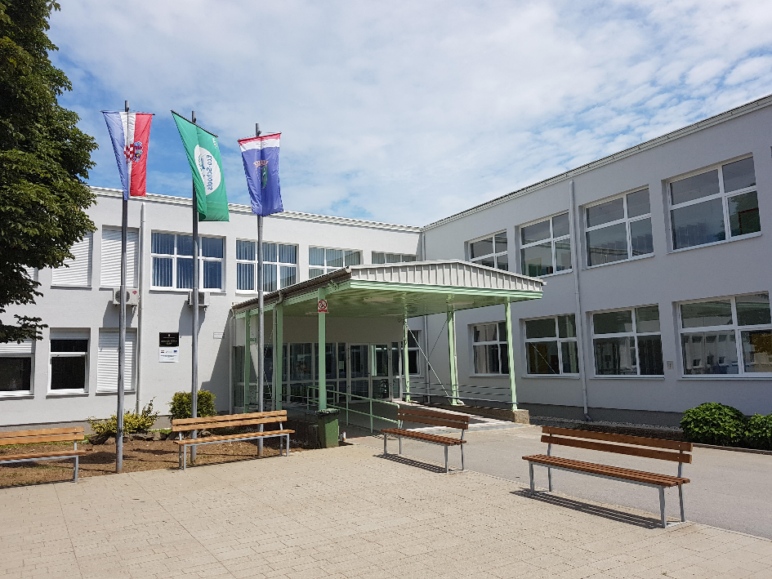
Osnovna škola Glina,
Glina, Croatia

Slide 2
About us….
Osnovna škola Glina has 467 students.
Our students are from 6 to 14 years old.
There are 80 people working in our school from which there are 55 teachers.
We work in 2 rotating shifts – morning & afternoon.
One week students go to school in the morning from 8,00 to 13,10 and next week in the afternoon from 13,45 to 18,55.

Slide 3
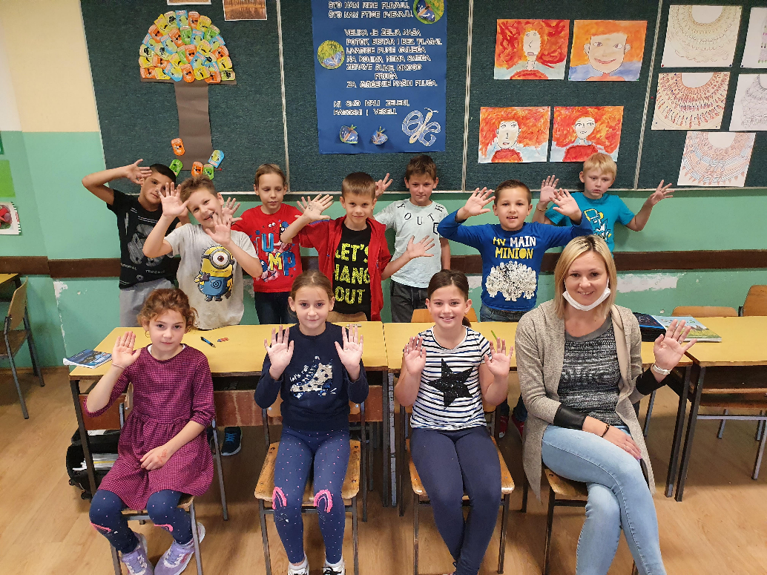
Classes working on HMBE project
Hi everyone! We are class 3.b. This is our teacher Andrijana.

Slide 4
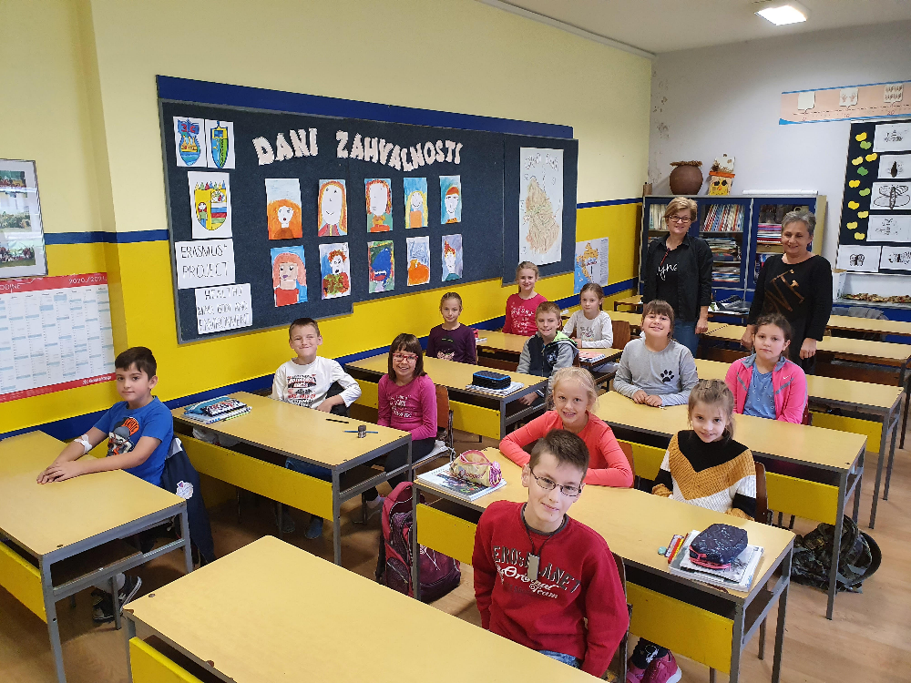
Classes working on HMBE project
Hi everyone! We are class 3.c. This is our teacher Štefica
and special needs student assistant Nataša

Slide 5
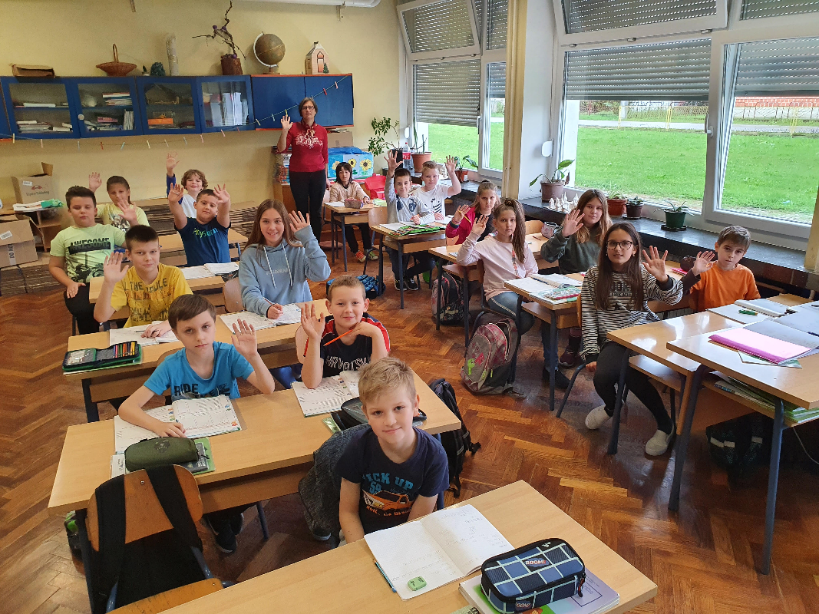
Classes working on HMBE project
Hi everyone! We are class 4.c. This is our teacher Jana.

Slide 6
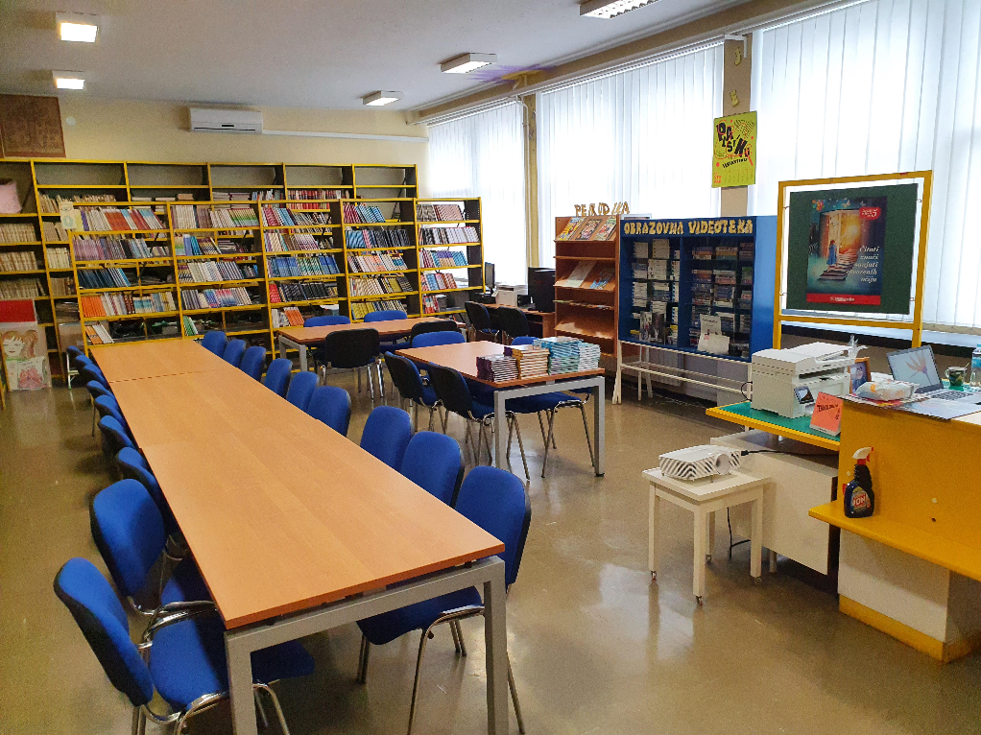
Interesting places in our school
School library

Slide 7
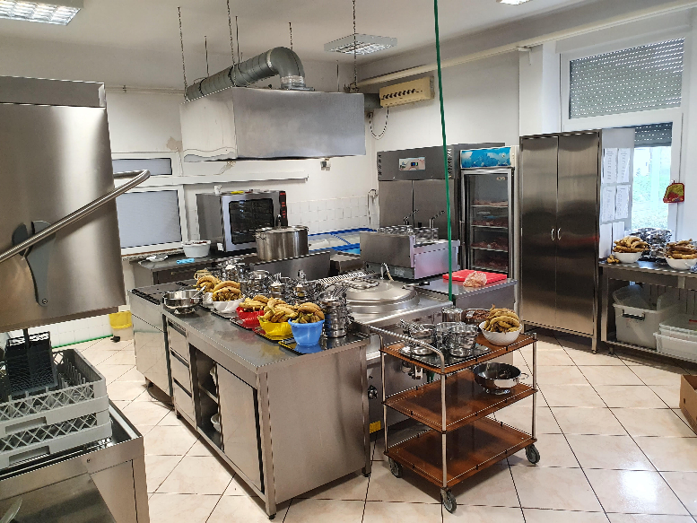
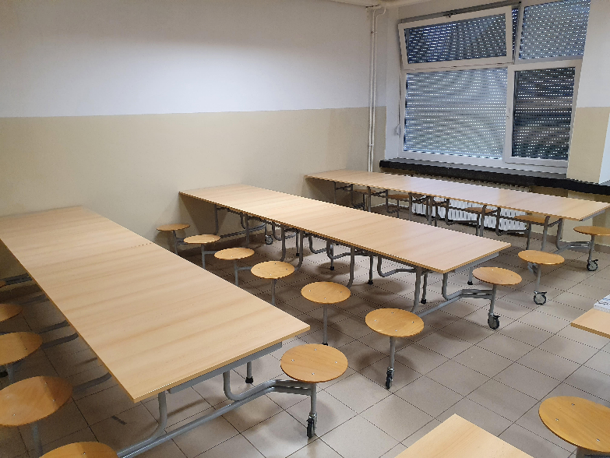
Interesting places in our school
School kitchen & dinning room

Slide 8
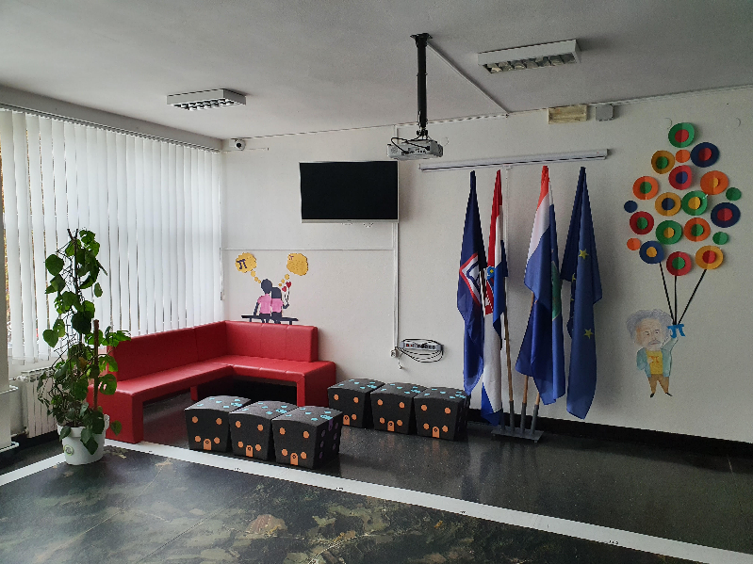
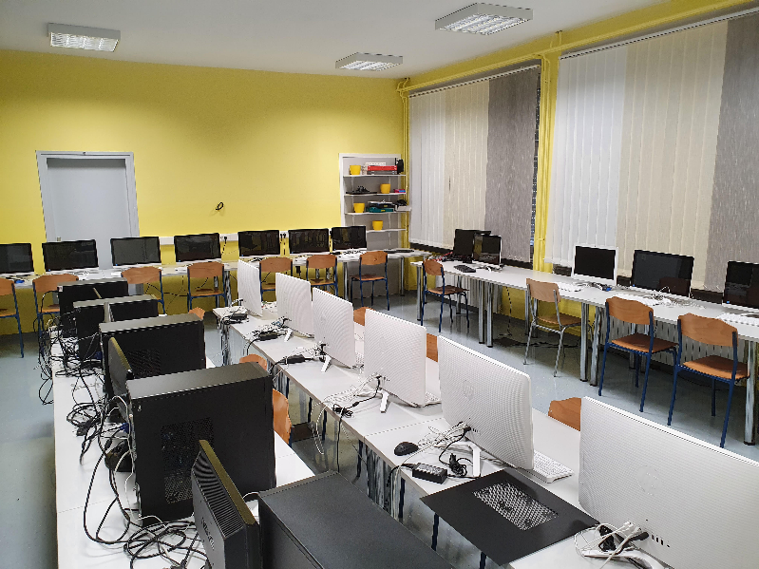
Interesting places in our school
Leisure corner / ICT class

Slide 9
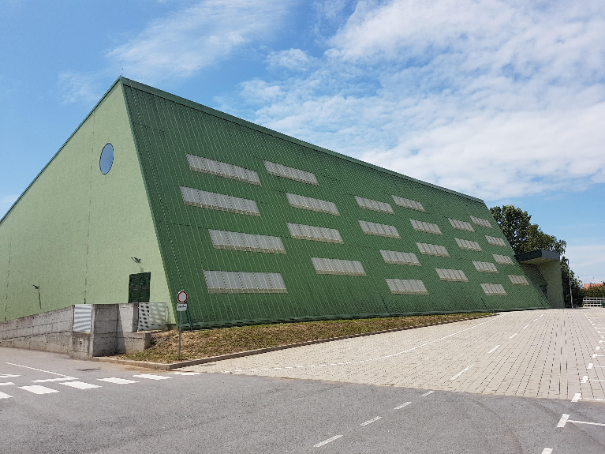
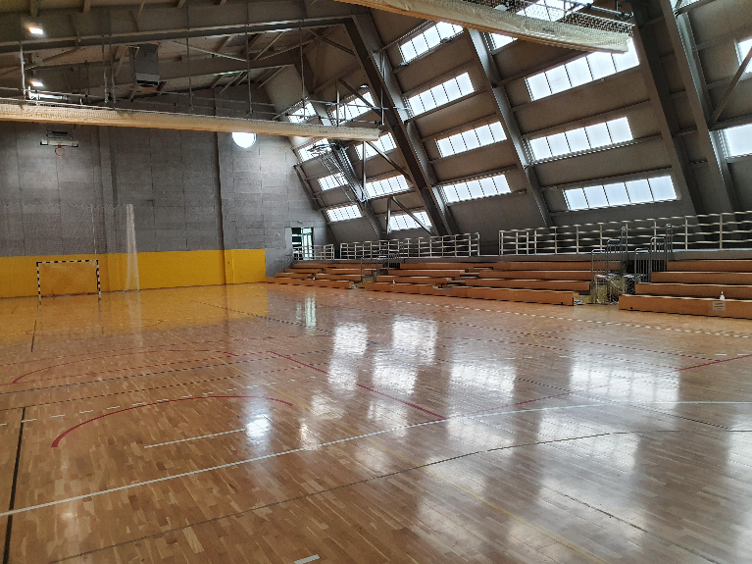
Interesting places in our school
School gym

Slide 10
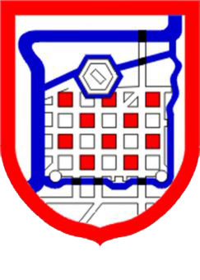
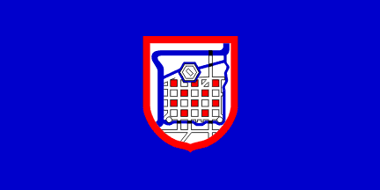
Our town - Glina
We live in a town called Glina.
Glina is a small town 70 km from our capital city Zagreb.
Glina has around 9300 inhabitants.

Slide 11
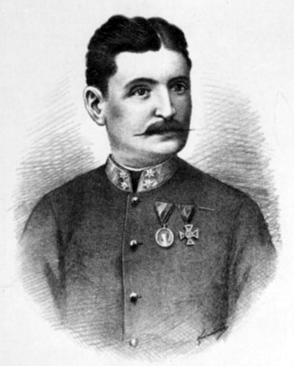

Our town - Glina
Glina is famous because Croatian national anthem was composed in Glina.
It is called „Lijepa naša domovino” and Josip Runjanin composed it in 1848.

Slide 12
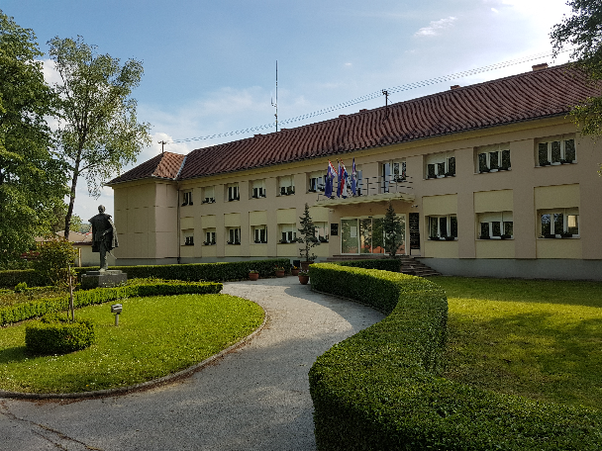
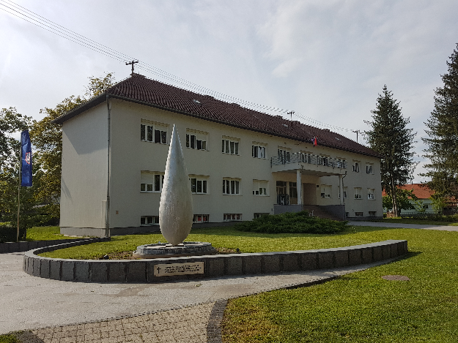
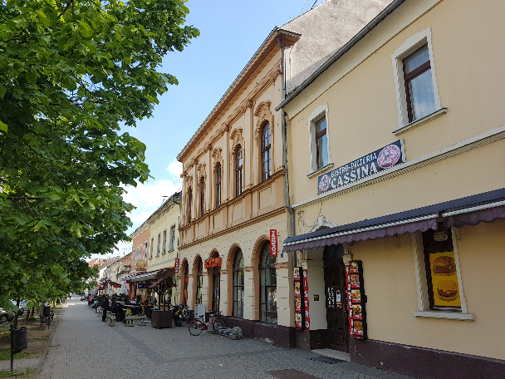
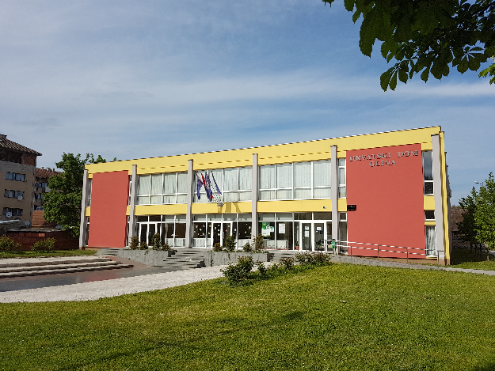
Pictures of our town Glina

Slide 13
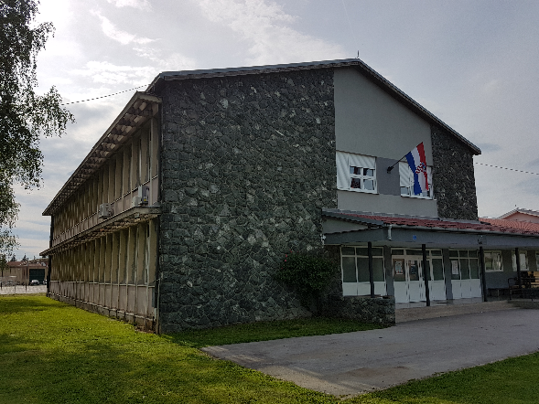
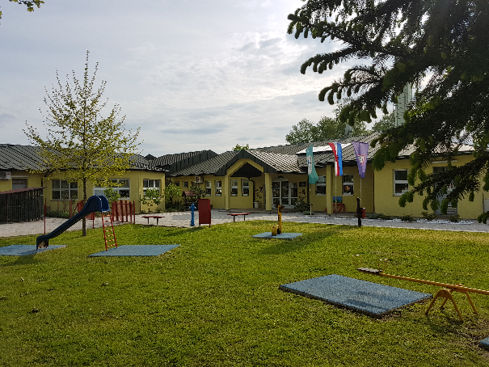
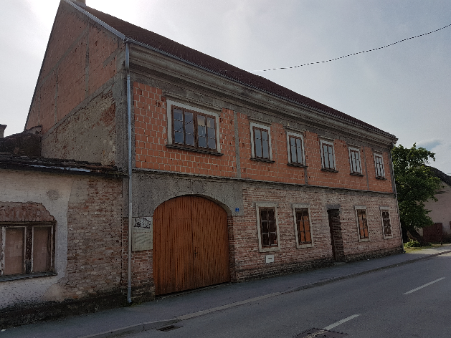
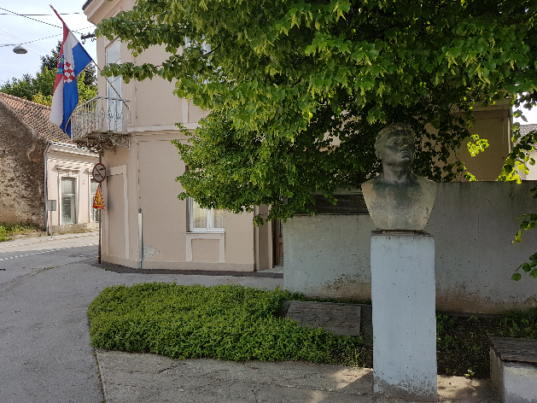
Pictures of our town Glina

Slide 14
Our 7th grade students made a video about our school & town.
Link to the video:
https://youtu.be/1QS8BtY-_KU
We are happy to work with you all on this project and hope to welcome you in our school and town.
Greetings from Croatia!

