Slide 1
EDUARD SLAVOLJUB PENKALA
Žana Đukić, Ana Marinčić, Manuela Perak, Petar Brkić

Slide 2
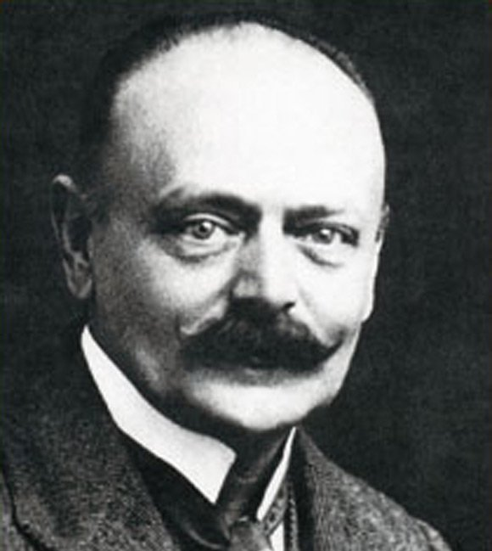
About Slavoljub Penkala
Eduard Penkala was born in 1871. in Liptovsky Mikulas
He had a Polish father and a Dutch mother, both of whom urged him to become a doctor
Finally, he moved to Croatia´s capital, Zagreb, with his family

Slide 3
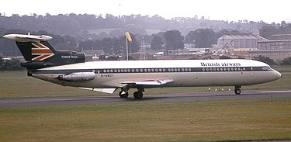
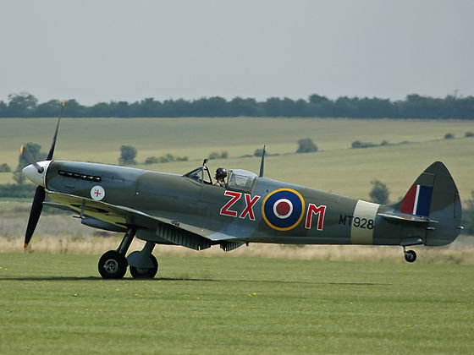
His creatons
His first invention was a thermophore in 1903, which is considered to be the forerunner of a thermos bottle.
Two years later he announced a new design-a rotating toothbrush. Apparently, the idea for invention came because of his daughter Thee who didn´t like to brush her teeth. He decided to help her by creating a rotating toothbrush
All the money he earned from the pen, he invested in the construction of the first Croatian plane. During the aircraft construction, Penakala built a hangar on military trainig ground and created the first runway in Croatia.
Ta fotografija korisnika Nepoznat autor: licenca CC BY-SA
Ta fotografija korisnika Nepoznat autor: licenca CC BY-SA

Slide 4
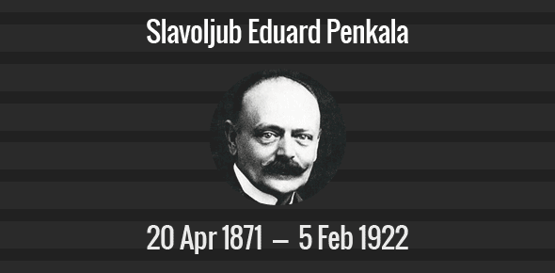
His death
He died in 1922 at the age of 51. His creativity made Croatia very proud, and we will always try to embrace his great achievements!

