Slide 1
Nikola Tesla
Written by: Gabriel Cerjak, Teodora Perak, Manuela Žužić, Gabrijel Horvatić

Slide 2
Nikola tesla facts:
Nikola Tesla was born in Smiljan.
He was born on 10.July 1856.
He died on 7 January, 1943 in NewYork.
He was an inventor and a engineer by profession
He made his first light bulb in Zagreb.
Tesla is enrolling at the Polytechnic High School in Graz with a scholarship from the Military Frontier

Slide 3
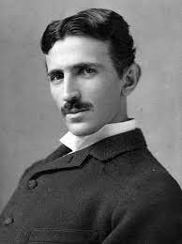
This is what he looked like
After the death of his father, he worked for a short time in the real grammar school in Gospić
Tesla establishes its own company Tesla Electric and Manufacturing Company.
Tesla founded the Tesla Electric Company with a loan from A. K. Brown, director of Western Union
By the time the great economic crsis in the United States lasted, Tesla`s company was failing.
v

Slide 4
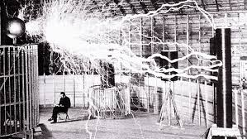
About him:
Tesla died on January 7 around 10:30pm in Apartment 3327 on 33rd floor of the New Yorker Hotel at 86.
Tesla was bulding a laboratory in Colorado Springs.
Tesla moves to Hotel St. Regis where he lived until 1923.
Tesla is making the first model of a turbine in which it applies a new system of fluid energy utilization throught friction.
Tesla moves into Hotel New Yorker , apartment 3327, in which he resides until he his death.

