Slide 1
PROBLEMS WITH CRUISE SHIPS
BY: ANTE NOVOSEL AND DOMAGOJ LISAC

Slide 2
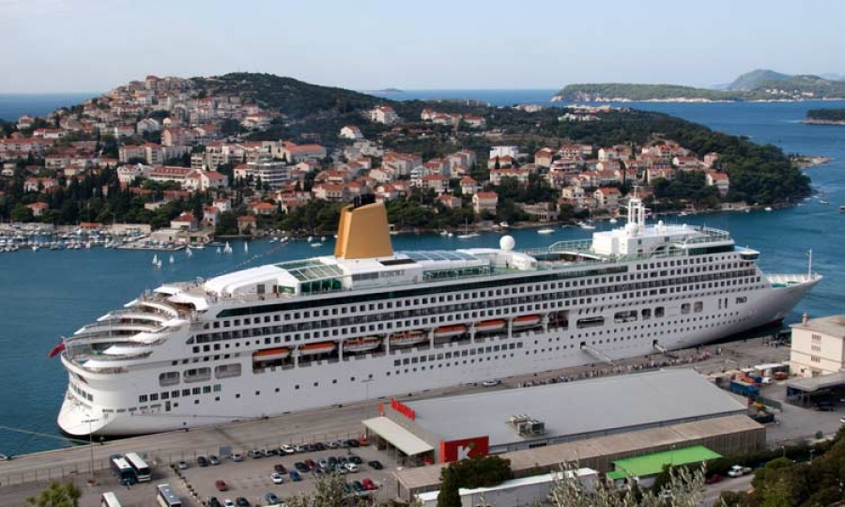
CRUISE SHIPS HAVE BECOME A BIG PROBLEM BECAUSE THEY POLLUTE THE SEA AND THE ENVIRONMENT
THEY HAVE BEEN CAUGHT DISCARDING TRASH, FUEL, AND SEWAGE DIRECTLY INTO THE OCEAN
PASSENGER’S CARBON FOOTPRINT TRIPLES IN SIZE WHEN TAKING A CRUISE
THAT IS WHY THE MOST COUNTRIES HAVE BANNED CRUISE SHIPS

Slide 3
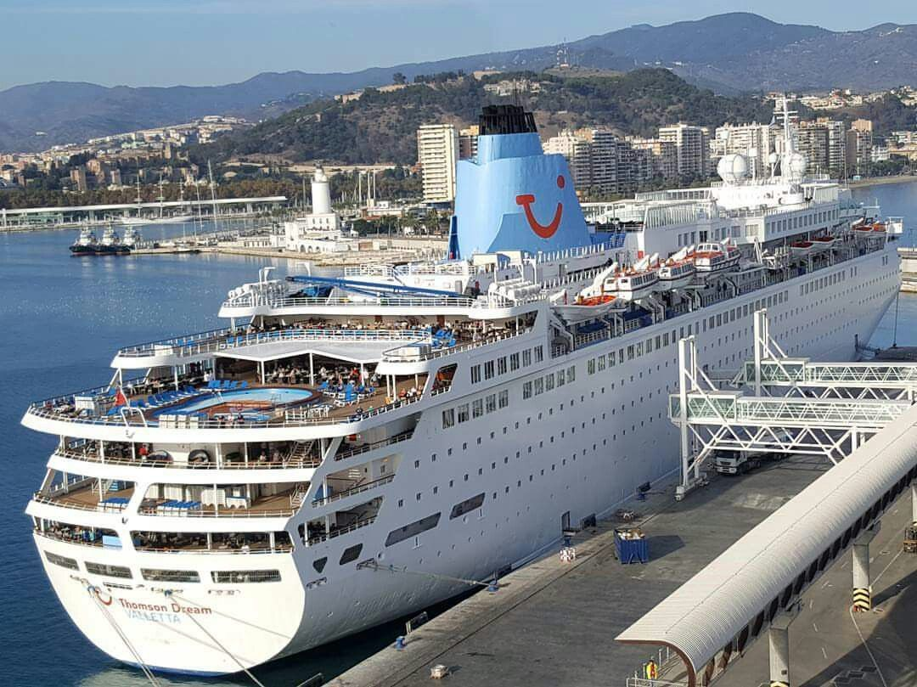
CRUISE SHIPS IN DUBROVNIK
IN CROATIA THEY ARE A VERY BIG PROBLEM ONLY IN DUBROVNIK
THIS YEAR CAME ABOUT 300 SHIPS AND THEY POLLUTED MORE THAN ALL EUROPEAN CARS
ANOTHER PROBLEM IS BECAUSE OF CRUISE SHIPS PEOPLE ARE MOVING OUT OF THE CITY CENTER AND THERE, YOU WILL FIND JUST SHOPS AND STORES

Slide 4
HOW CROATIA WANTS TO DEAL WITH THE PROBLEM OF CRUISE SHIPS ?
CROATIA WANTS TO BAN THE ARRIVAL OF CRUISERS
THAT WOULD BE A BAD MOVE FOR TOURISM BECAUSE MOST TOURISTS COME BY CRUISE SHIPS DESPITE OF THE FACT THAT CRUISERS POLLUTE THE ENVIRONMENT AND THE SEA
BUT THERE IS ANOTHER WAY TO SOLVE THIS PROBLEM…

Slide 5
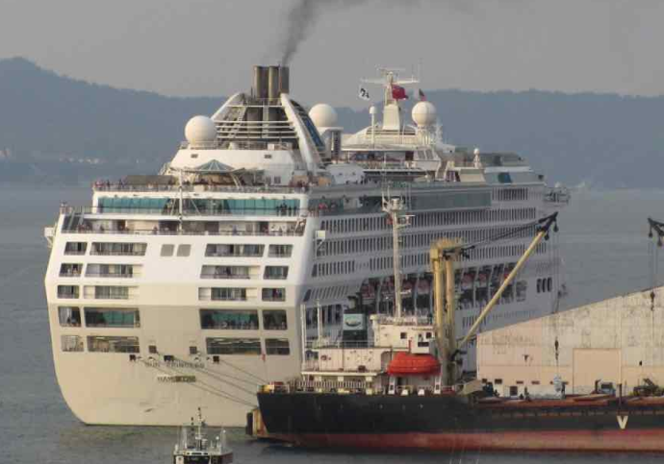
WHAT WE NEED TO DO WITH CRUISE SHIPS IN CROATIA?
USING ‘CLOSED-LOOP SCRUBBERS’ WOULD REDUCE CRUISE SHIP POLLUTION SIGNIFICANTLY
THEY STORE THE WASTE MATERIALS FOR TREATMENT ON LAND
THAT WILL KEEP THE TOURISTS AND THE CLEAN SEA AS WELL

